Slide 1


Multi-Purpose AI Password Analysis Tool
Offensive and Defensive AI Warfare
Notes:
Osama Khalid

Slide 2

Multi-Purpose AI Password Analysis Tool
Group Members
Osama Khalid (Team Leader)
Sardar M. Zeeshan khan
Salman Ali
Department of Computing, Riphah International University, I-14, Islamabad.
Supervisor: Dr. Mansoor Alam
Notes:
Osama Khalid

Slide 3

"The only truly secure system is one that is completely powered off, cast in concrete, and sealed in a lead-lined box buried a mile underground ."
-Bruce Schneier (security expert)
Notes:
Osama Khalid

Slide 4
Table of Content
Introduction and Background
Opportunities and Stake Holders
Existing Systems
Requirements
Software System
Endeavour
Future Works and Next Steps
Prototype / Practical Demo
Notes:
Osama Khalid

Slide 5

Introduction and Background
Notes:
Salman

Slide 6
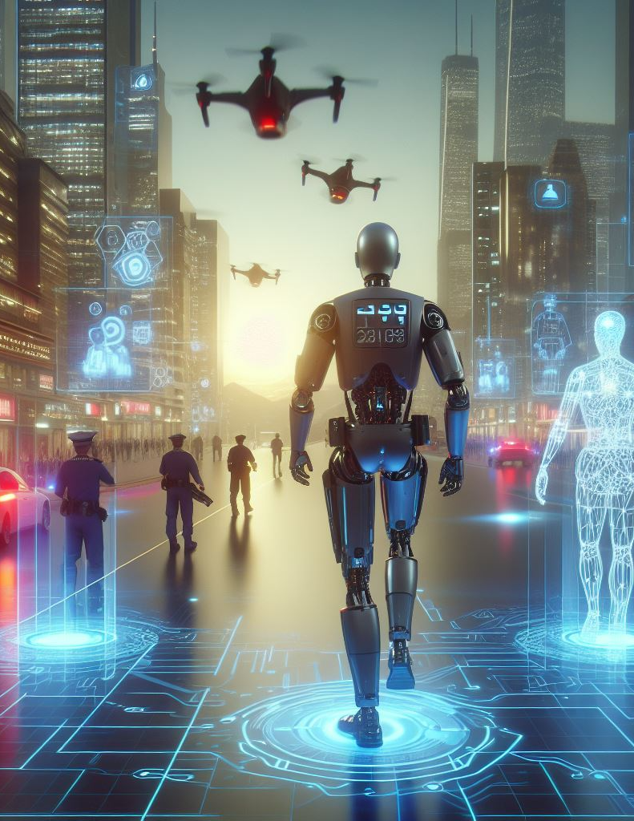
AI: Transforming Offensive and Defensive Security
Offensive Applications:
Threat Modeling
Vulnerability Analysis
Automated Attacks
Defensive Applications:
Anomaly Detection
Intrusion Prevention.
Personalized Security Solutions
Notes:
Salman

Slide 7

Opportunities and Stake Holders
Notes:
Salman

Slide 8

Opportunities
Enhanced Security Assessments: Businesses and individuals can leverage the tool for penetration testing and vulnerability assessments, identifying potential weaknesses in their password security policies and practices.
AI-driven Offensive and Defensive Capabilities: Utilizing AI for both offensive (password cracking) and defensive (password strength assessment) purposes provides a comprehensive approach to password security management.
Notes:
Salman

Slide 9

Stake Holders
Businesses: Companies aiming to improve their overall cybersecurity posture by identifying and mitigating password-related vulnerabilities.
Security Professionals: Penetration testers and security consultants who can use the tool for vulnerability assessments and ethical hacking activities.
Law Enforcement: Agencies might leverage the tool for lawful investigations adhering to court orders and legal guidelines.
Notes:
Salman

Slide 10

Existing Systems
Notes:
Salman

Slide 11
Tool | John the Ripper | RainbowCrack | OphCrack | L0phtCrack | Aircrack-ng
Type | Password Cracker | Password Cracker | Password Cracker | Password Cracker | Wi-Fi Network Security Tool
Supported Platforms | Windows, Linux, macOS | Windows, Linux | Windows, Linux | Windows | Linux, macOS
Password Hashes Supported | Various (Unix, Windows, etc.) | LM, NTLM, MD5, SHA1, SHA256, SHA512 | LM, NTLM | LM, NTLM | WEP, WPA, WPA2
Attack Methods | Dictionary, Brute Force, Hybrid | Precomputed Hash Tables | Rainbow Tables, Brute Force | Dictionary, Brute Force | Dictionary, Brute Force, WPS PIN
Speed | Fast | Depends on Rainbow Table size | Moderate | Fast | Depends on hardware and complexity of the password
User Interface | Command Line | Command Line | GUI | GUI | Command Line
License | Open Source | Freeware | Open Source | Commercial | Open Source
Usage | Penetration Testing, Password Auditing | Password Cracking | Password Recovery | Password Cracking | Wi-Fi Network Security Testi
Notes:
Salman

Slide 12

"Your password is the key to your digital life. Choose it wisely, and guard it fiercely."
Notes:
Zeeshan

Slide 13
Requirements
Notes:
zeeshan

Slide 14
Requirements
Hardware Requirements
Software Requirements
Dataset Requirements
Notes:
zeeshan

Slide 15
Hardware Requirements
Workstation HP Z840
Processor Intel Xeon E5-2680 V4 Dual
RAM 64GB DDR4 ECC
GPU RTX 3070TI 8GB GDDR6x.
SSD 512 GB
Notes:
zeeshan

Slide 16
Software Requirements
Windows 11 64bit
Visual Studio
Python 3.12
TensorFlow
Pytroch
cuDNN
Notes:
zeeshan

Slide 17
Datasets Requirements
Notes:
zeeshan

Slide 18
Datasets
Get a mix of passwords from various sources, like:
Online leaks and breaches (follow ethical and legal guidelines).
Making sure our dataset covers a wide range of password types, including different lengths, complexities, and compositions.
Notes:
zeeshan

Slide 19
Datasets Requirements
Notes:
zeeshan

Slide 20
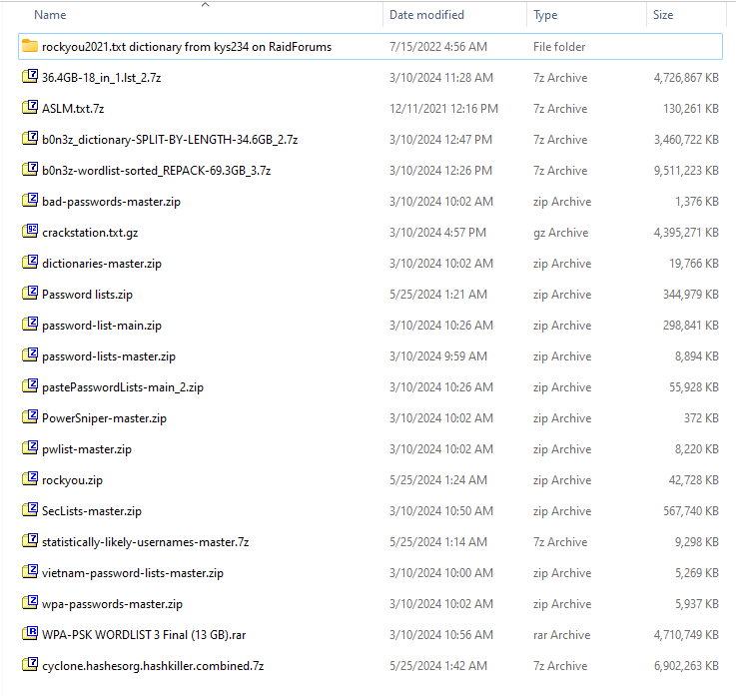
Datasets Requirements
Notes:
zeeshan

Slide 21
Software System
Design
Notes:
Osama

Slide 22
Spine of the System
Notes:
Osama

Slide 23
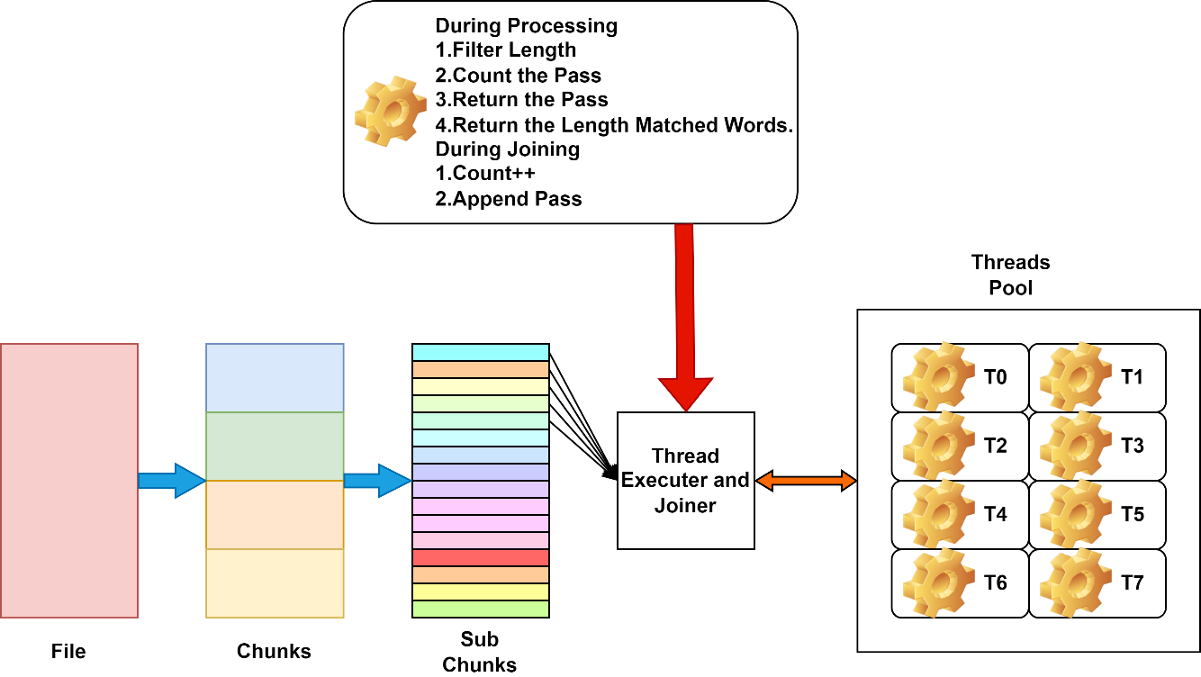
Notes:
Osama

Slide 24
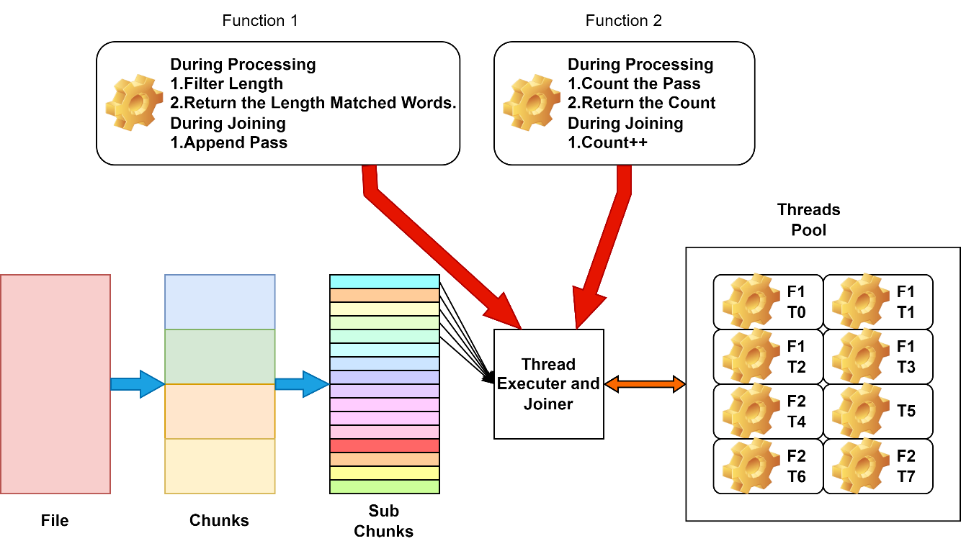
Notes:
Osama

Slide 25
Software System Design
Dataset
Algorithms
Data Splitter
Data Filter
RNN Train
RNN generate
Transformer Train
Transformer Generate
GANS Train
GANs Generate
Notes:
Osama

Slide 26
Dataset
Design
Notes:
Osama

Slide 27
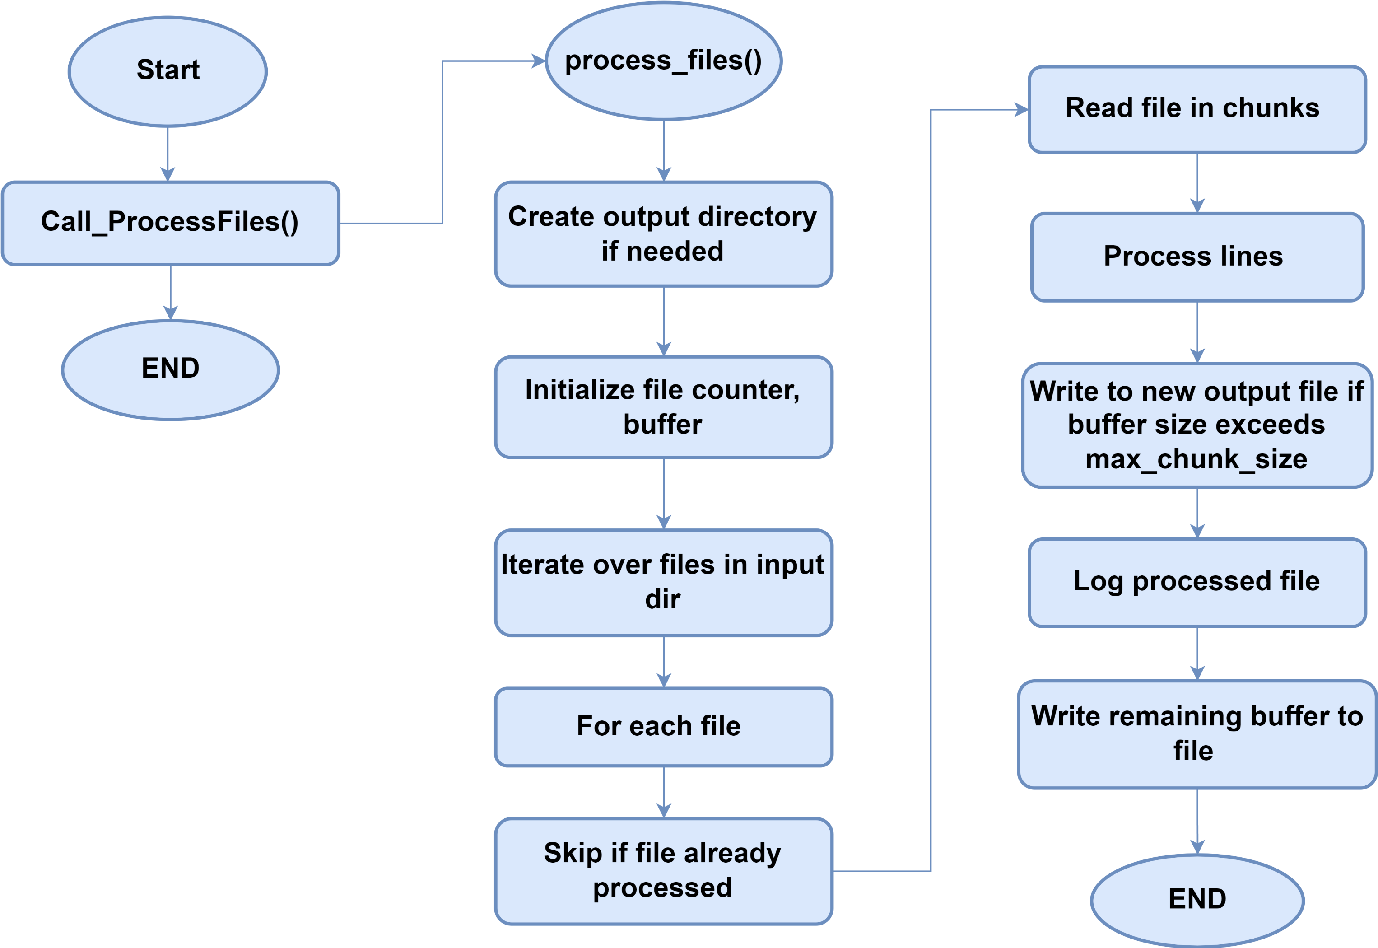
Data Splitter
Notes:
Osama

Slide 28
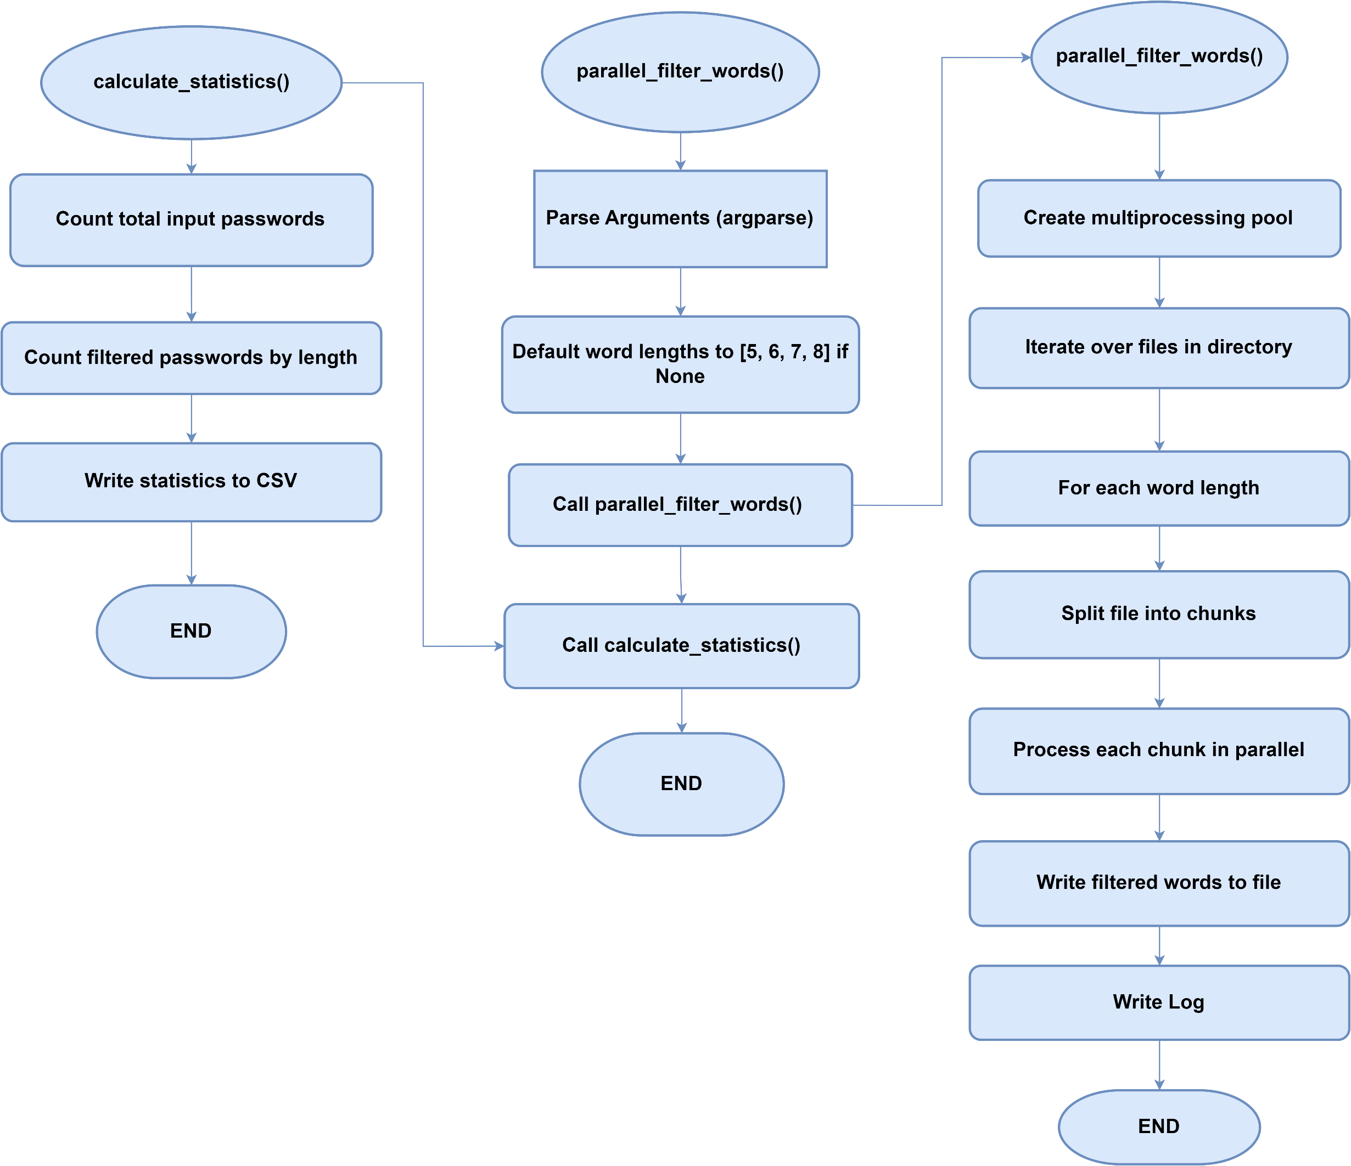
Data Filter
Notes:
Osama

Slide 29
Algorithms
Design
Notes:
Osama

Slide 30
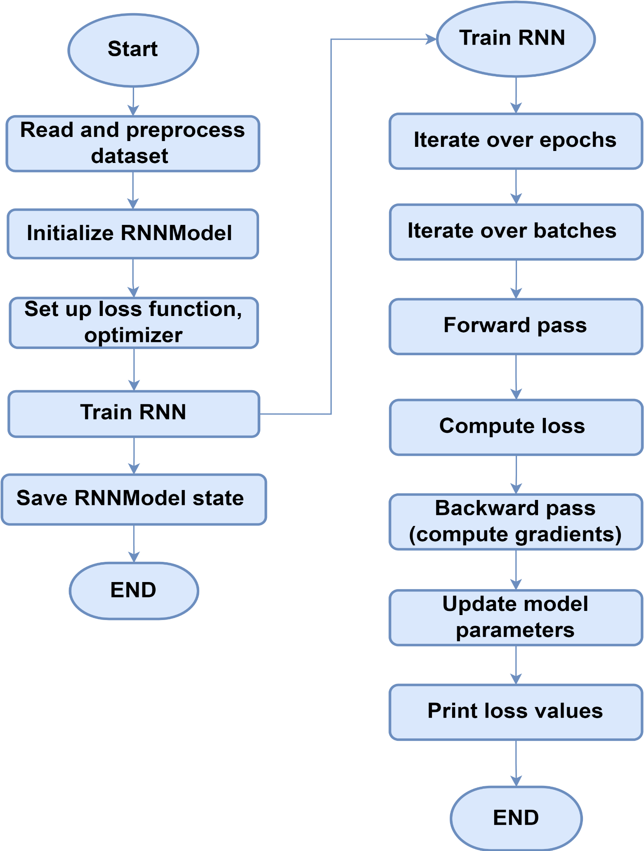
RNN Train
Notes:
Osama

Slide 31
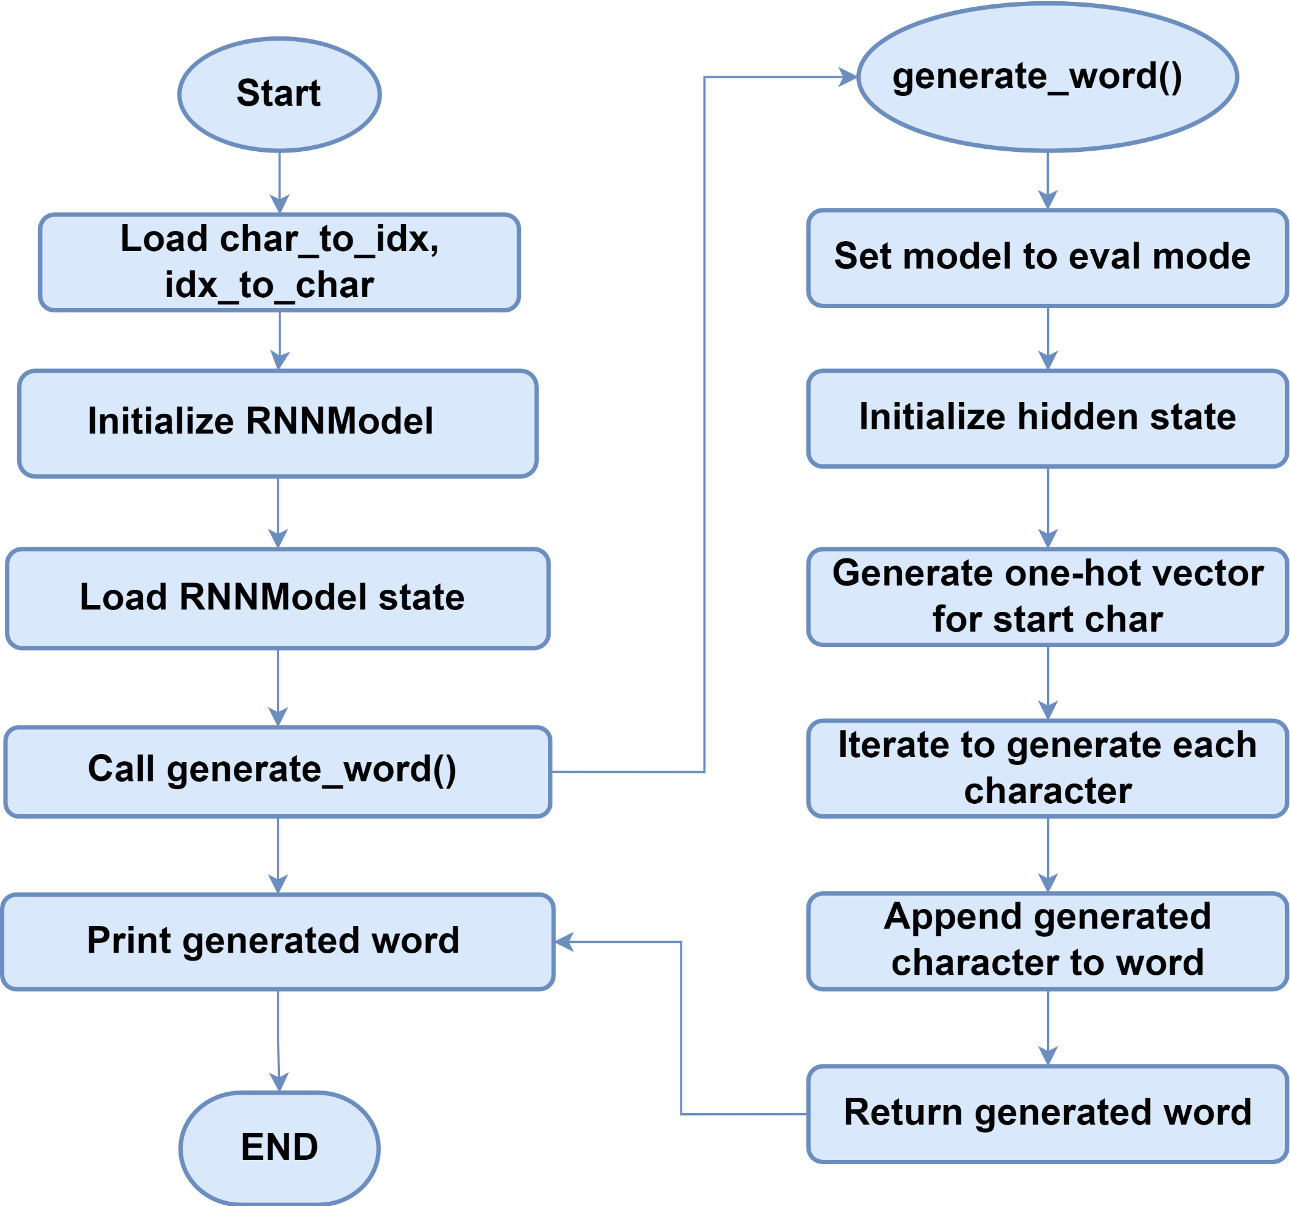
RNN Generate
Notes:
Osama

Slide 32
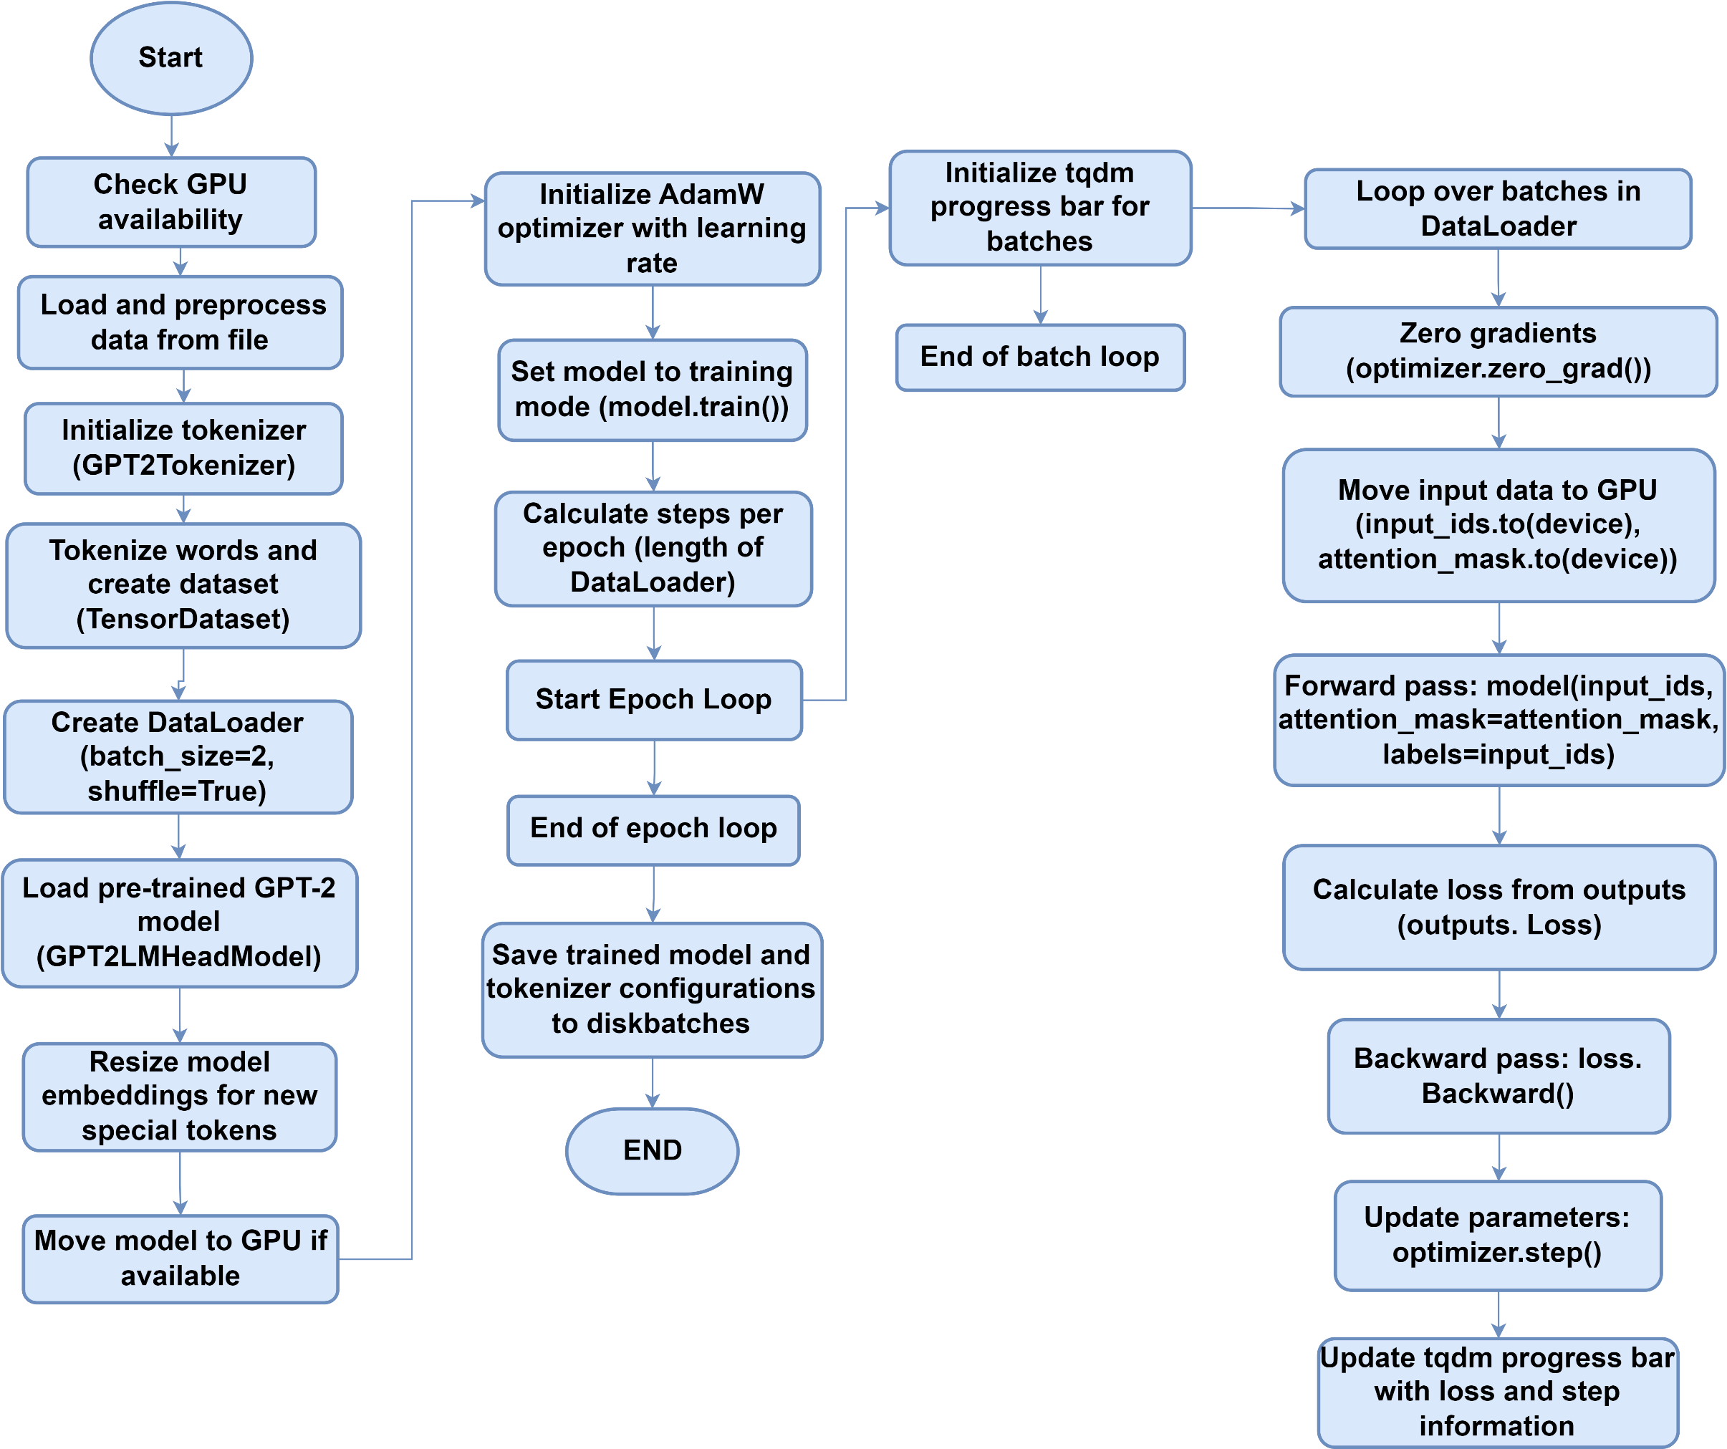
Transformer Train
Notes:
Osama

Slide 33
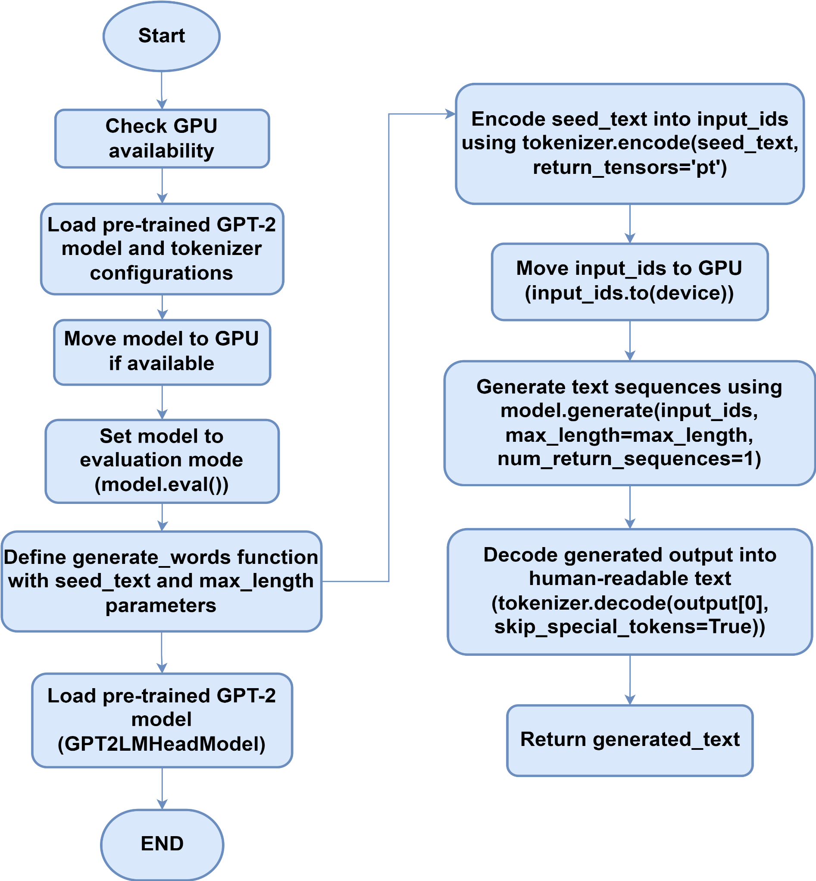
Transformer Generate
Notes:
Osama

Slide 34
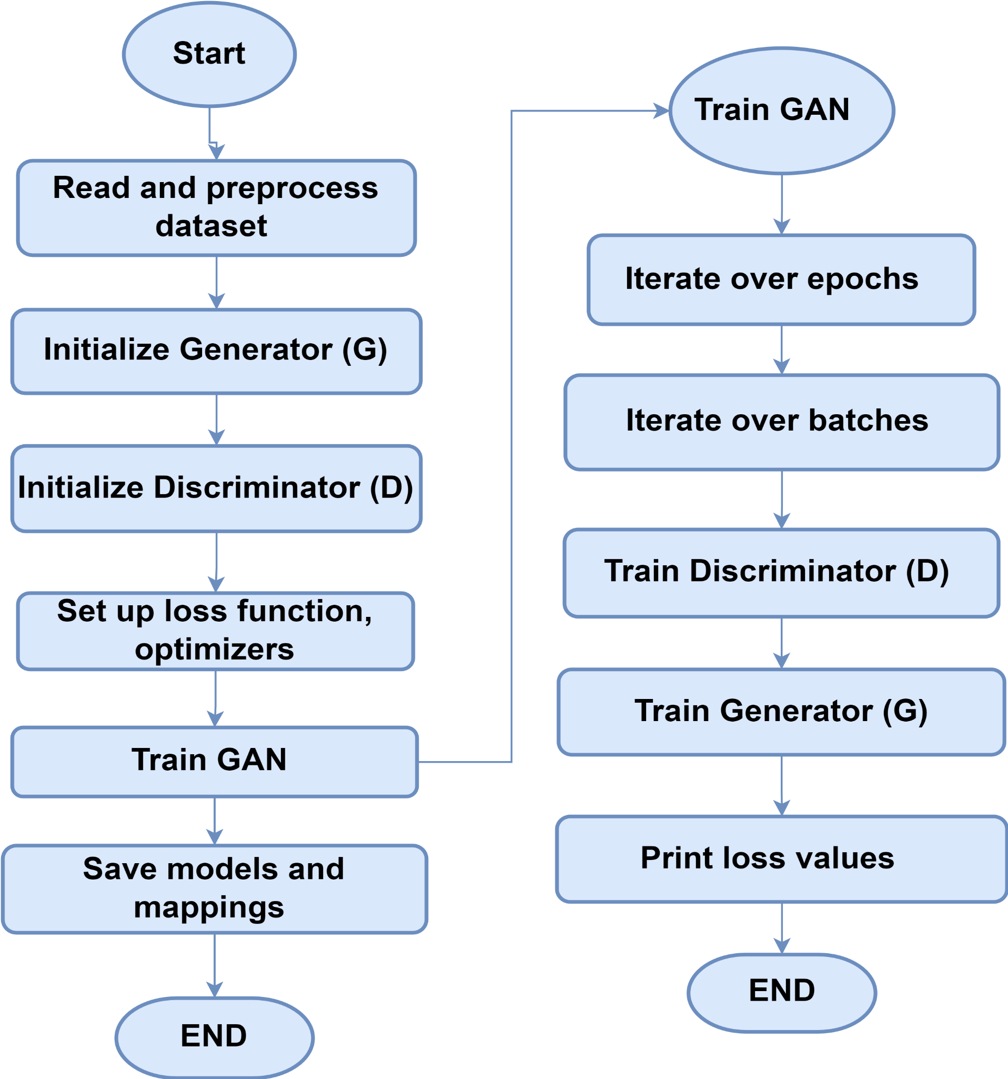
GANs Train
Notes:
Osama

Slide 35
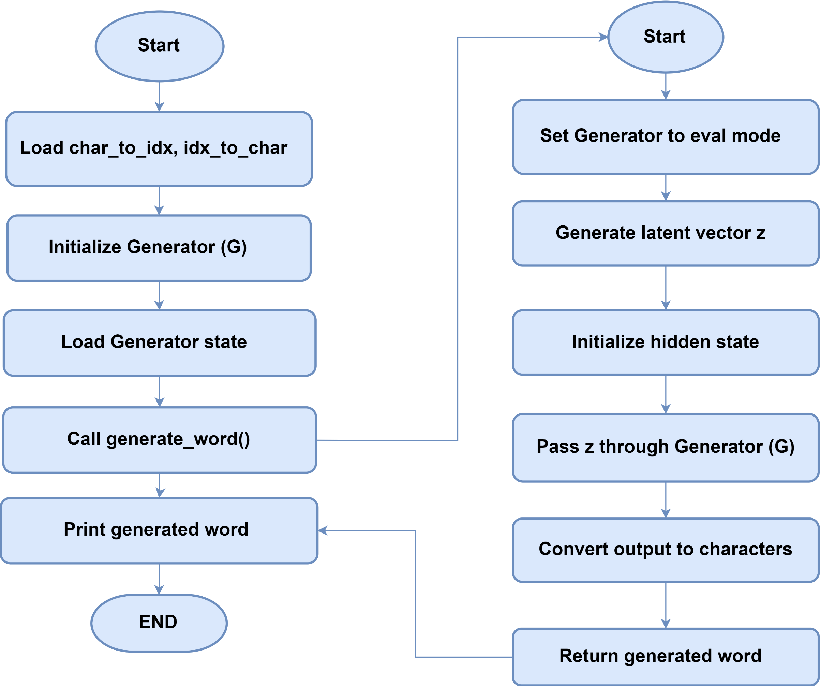
GANs Generate
Notes:
Osama

Slide 36
Endeavour
Notes:
Zeeshan

Slide 37
WBS # | WBS Deliverable | Activity # | Activity to Complete the Deliverable | Responsible Team Member(s) & Role(s)
1 | Requirements | 1.1 | Hardware Requirements | Osama Khalid
 |  | 1.2 | Software Requirements | Osama Khalid, Zeeshan Khan, Salman Ali
2 | Phase 1: Develop and Train the AI Model | 2.1 | Research and select appropriate AI algorithms for password analysis. | Osama Khalid, Zeeshan Khan, Salman Ali
 |  | 2.2 | Acquire or prepare relevant password datasets for training. | Zeeshan Khan
 |  | 2.3 | Train and optimize the chosen AI model with the selected datasets. | Osama Khalid
3 | Phase 2: Implement Core Functionalities | 3.1 | Design and develop functionalities for password strength analysis. | Osama Khalid, Zeeshan Khan, Salman Ali
 |  | 3.2 | (Optional) Integrate password breach checking with online databases (securely).
 |  | 3.3 | Develop functionalities for automated password cracking (ethical considerations apply). | Osama Khalid, Zeeshan Khan, Salman Ali
4 | Phase 3: Design and Develop User Interface | 4.1 | Design a user-friendly interface for both offensive and defensive functionalities.
 |  | 4.2 | Integrate the trained AI model and core functionalities into the user interface.
5 | Phase 4: Testing and Refinement | 5.1 | Conduct thorough testing of all functionalities with various password scenarios. | Osama Khalid, Zeeshan Khan, Salman Ali
 |  | 5.2 | Refine the AI model, user interface, and functionalities based on testing results.
 |  | 5.3 | Document user manuals and instructions for the completed tool.
Notes:
Zeeshan

Slide 38
Future Works and Next Steps
Notes:
Zeeshan

Slide 39
Future Works and Next Steps
Modularizing AI Algorithms
Optimizing AI Algorithms
Enhancing Dataset Quality
Developing Remaining Modules
Integration and Testing
Deployment and Monitoring
Notes:
Zeesshan

Slide 40
Modularizing AI Algorithms
Objective: Enhance efficiency and maintainability
Actions:
Break down AI algorithms into smaller, manageable modules
Implement and test each module independently
Notes:
Zeeeshan

Slide 41
Optimizing AI Algorithms
Objective: Improve algorithm performance and speed
Actions:
Analyze current performance bottlenecks
Apply optimization techniques (e.g., algorithmic improvements, hardware acceleration)
Benchmark and compare performance before and after optimization
Notes:
Zeeshan

Slide 42
Enhancing Dataset Quality
Objective: Improve model accuracy and reliability
Actions:
Conduct thorough data cleaning and preprocessing
Augment datasets with additional high-quality data
Implement data validation and integrity checks
Notes:
Zeeshan

Slide 43
Developing Remaining Modules
Objective: Complete the project development cycle
Actions:
Identify and outline the remaining modules to be developed
Assign tasks and deadlines for each module
Conduct iterative testing and integration
Notes:
Zeeshan

Slide 44
Integration and Testing
Objective: Ensure seamless integration and functionality
Actions:
Integrate newly developed modules with existing system
Conduct comprehensive testing (unit, integration, system)
Perform user acceptance testing and gather feedback
Notes:
Zeeshan

Slide 45
Deployment and Monitoring
Objective: Deploy the project and ensure continuous performance
Actions:
Deploy the project in the target environment
Set up monitoring and alerting systems
Collect performance data and optimize as needed
Notes:
Zeeshan

Slide 46
Prototype / Practical Demo
Notes:
Osama

Slide 47

Any Question?
27971@students.riphah.edu.pk
Notes:
Osama

Slide 48

References
https://posts.specterops.io/deeppass-finding-passwords-with-deep-learning-4d31c534cd00
https://ieeexplore.ieee.org/abstract/document/9552430
https://www.sciencedirect.com/science/article/pii/S0020025518302366?casa_token=QnobZtTT-nQAAAAA:ZUQdmVBOId58XFG1Sp5xbuBLQdIui7dvw4fKJzUqfwLr6doVbFtBep38V2hDqVt_26zTbM_Sj5I
Notes:
Osama

